Slide 1
NATURAL LANGUAGE PROCESSING
HOMEWORK – 4
By Ravinthiran Partheepan

Slide 2
Query
Analyze non-normative texts of your language.
Try to think how the diacritics problem can affect different NLP tasks (e.g. search, machine translation, etc.).

Slide 3
Non Normative Definition
'Normative' means 'what you should do' or 'what you must do', the rules that you are supposed to follow.
So 'non-normative' means 'what is recommended to be done', the suggestions on how to do things well (within the formal specifications laid out in the 'normative' part). It can also mean 'how people generally do things' whatever the formal rules say.
Non-normative: No norms and principals but you may kindly follow.

Slide 4
How Diacritics Problem Affects Various NLP Task?
In Speech Recognition Field the Input Sentence may recognized differently but it have the Same synposis for eg : I Say “ Describe Semantic Textual Similarity (STS) ?” and “ Describe STS ?”
the Result may Varies because When hashing the Provided Input in Abbrevated Format the hashed Intermediate will pop-ups different Target Value For Eg :-> STS – Start your Jouney, Student Tracking System, Semantic Textual Similarity.......
The Same Hashing will occur in Machine Translation and Search Engine Comment

Slide 5
Technical Aspects
Programming Language Used – R Script
Libraries Used – “tidytext,text_data,dplyr,sentimentr”

Slide 6
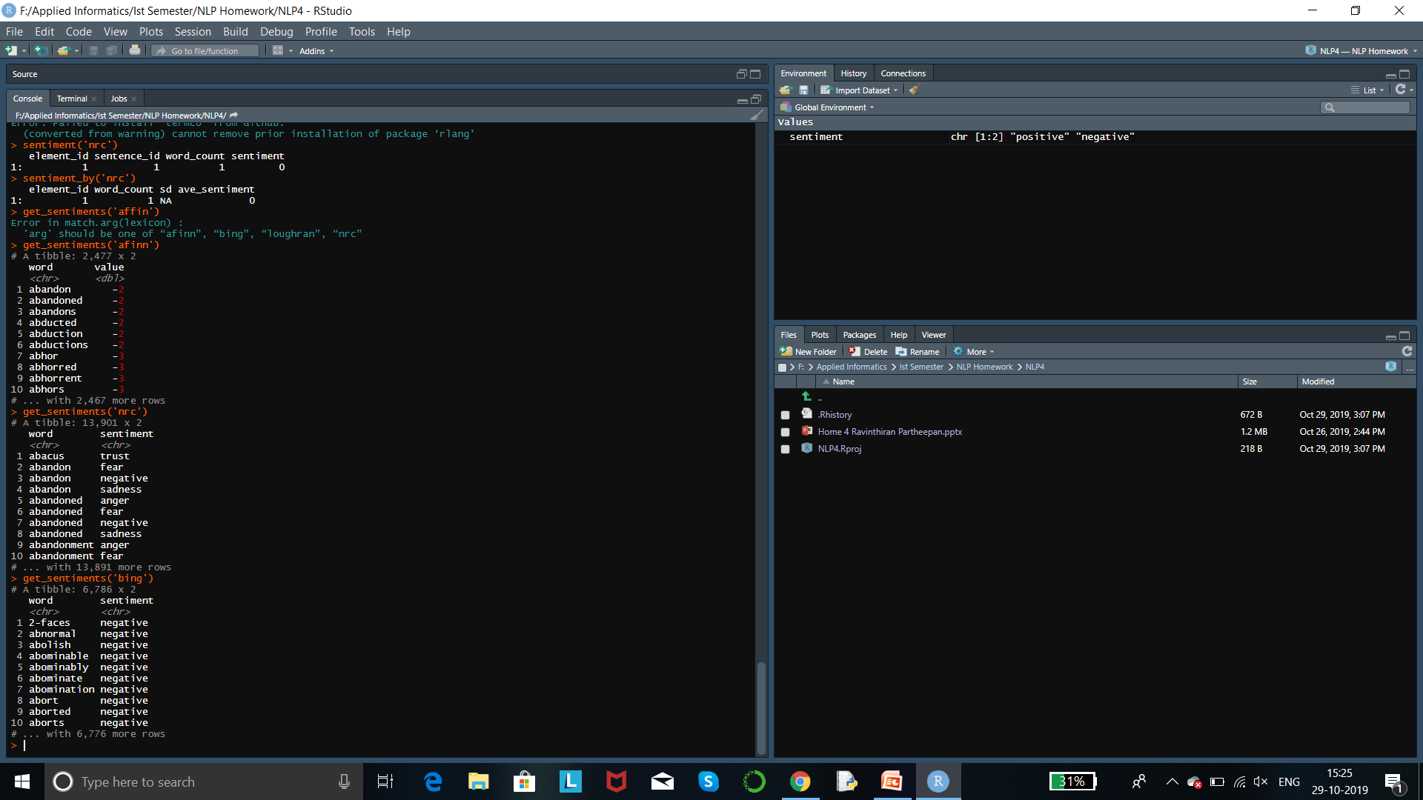
Analysis of Non-Normative Text

Slide 7
Analysis:-

Slide 8
Thank You!

